Slide 1
Team name: Screen Warriors
Team Members: P. Abhi Varshini
M. Shanmukha prasad
V. Sai Haasini
Branch: Cyber Security (2nd Year)
Problem Statement: Develop an AI driven system that helps bridge digital divide by offering virtual Labs and educational content for rural students.
Domain: Education

Slide 2
Solution:
Localized Study Materials:
Curriculum-specific materials for grades 1–10 in state syllabus (Telugu and English).
Interactive Virtual Labs:
Students can access experiment videos in their chosen language by selecting board, standard, and medium.
AI-Driven Learning Tools:
Theory Section: Generates concise, point-wise explanations of topics in Telugu or English.
Quiz Section: Offers 8 personalized MCQs with real-time feedback and explanations.
Summarization: Summarizes large text or PDFs for quick syllabus coverage.
Doubt Resolution: Provides solutions to text/image-based questions, including math problems and theoretical answers.
Summary Generator: Narrates a story on the given topic
Seamless User Experience:
User-friendly signup/login process with profile display.

Slide 3
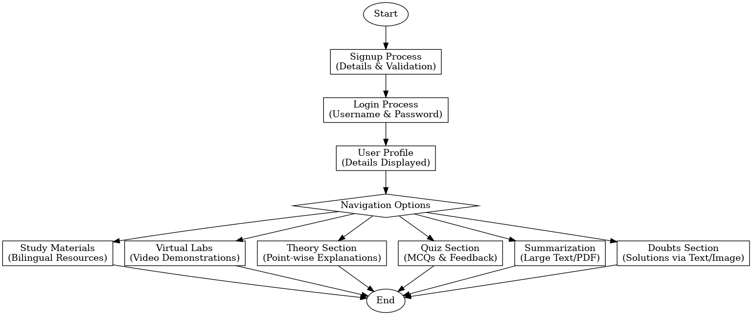
Flowchart:

Slide 4
Technology Stack :
Frontend: ReactJs
Backend: Python’s Flask
Database: Oracle SQL Developer
Editor: VS Code
AI: Gemini

Slide 5
Core Features:
Personalized Learning Resources:
Curriculum-specific materials for state syllabus (grades 1–10) in Telugu and English.
Interactive Virtual Labs:
Access to experiment videos and explanations in the selected language, fostering hands-on learning.
AI-Powered Learning Tools:
Point-wise theory generation, topic-based MCQ quizzes with real-time feedback, and large text/PDF summarization using AI (Gemini API).
Doubt Resolution:
AI-based text/image processing to solve theoretical and mathematical questions for students.
User-Centric Design:
Intuitive signup/login system with profile display and seamless navigation across features.

Slide 6
Applications:
Bridging the Digital Divide:
Provides access to quality education and virtual labs for rural students, overcoming geographical barriers.
Multilingual Learning:
Supports Telugu and English, ensuring inclusivity for students with different language preferences.
Enhanced Exam Preparation:
Offers AI-generated quizzes, summarized content, and doubt resolution for efficient and focused learning.
Interactive STEM Education:
Virtual labs make science and math experiments engaging and accessible, encouraging practical understanding.
Scalable Educational Model:
Can be expanded to other regions, languages, and educational boards for a broader impact.

Slide 7
Impact:
Improved Educational Access:
Empowers rural students by providing them with resources and tools that were previously inaccessible, promoting equality in education.
Enhanced Learning Experience:
Makes learning more engaging through AI-driven interactive tools like virtual labs, quizzes, and theory generation.
Faster Learning and Revision:
The summarization feature helps students quickly cover vast syllabi, making learning more efficient.
Boosted Academic Performance:
Real-time feedback on quizzes and doubt resolution tools help students grasp concepts better, improving exam readiness and overall performance.
Empowering Teachers and Students:
Teachers can utilize the resources to assist students, while students gain autonomy in their learning journey through personalized AI-driven content.

Slide 8
Conclusion:
In conclusion, this project aims to bridge the digital divide by providing rural students with access to personalized educational content, virtual labs, and AI-driven learning tools. By offering resources in both Telugu and English, it fosters an inclusive learning environment that supports academic growth and exam preparation. The platform empowers students and educators alike, ensuring a more efficient and engaging learning experience.

Slide 9

THANK YOU

